Slide 1
Artificial Neural Networks Algorithm
1. Initialize Weights and Bias
The algorithm starts by initializing the weights i.e the strength of connections between neurons and biases which is additional parameters that help to adjust output. These values are usually initialized randomly.
Set the learning rate (α) which controls how much the weights should be adjusted during training.
2. Feed Input Data
The input data is fed into the input layer of the network. Each input is a feature like an image pixel, a value from a dataset, etc.
3. Forward Propagation (Calculate Output)
The data is passed through the network from the input layer to the hidden layers and finally to the output layer. At each layer the input is multiplied by the weights and passed through an activation function like sigmoid, ReLU, etc to produce the output of that layer. The result is a prediction or an output that is compared to the actual target value.

Slide 2
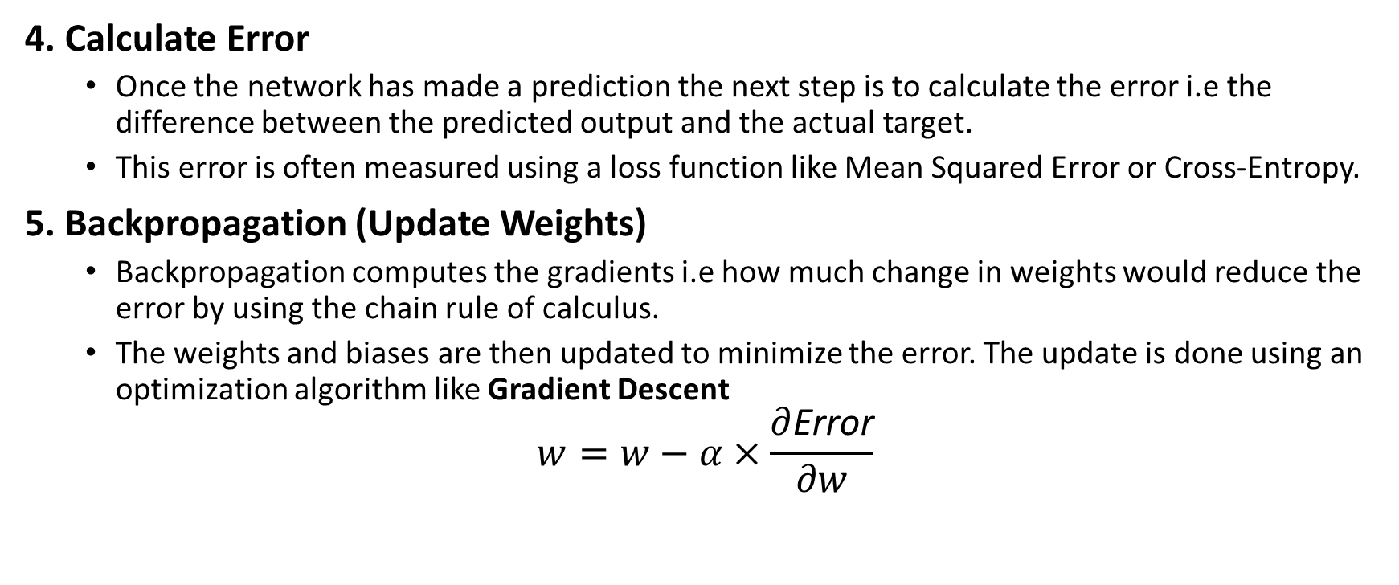
Artificial Neural Networks Algorithm
4. Calculate Error
Once the network has made a prediction the next step is to calculate the error i.e the difference between the predicted output and the actual target.
This error is often measured using a loss function like Mean Squared Error or Cross-Entropy.
5. Backpropagation (Update Weights)
Backpropagation computes the gradients i.e how much change in weights would reduce the error by using the chain rule of calculus.
The weights and biases are then updated to minimize the error. The update is done using an optimization algorithm like Gradient Descent
$$w=w−α×\frac{∂\text{Error}}{∂w}$$

Slide 3
Artificial Neural Networks Algorithm
6. Repeat (Epochs)
Steps 2 to 5 are repeated for multiple epochs which is iterations over the entire training dataset. During each epoch the weights are adjusted to reduce the error gradually.
7. Test the Network
After training, the network is tested with new data to evaluate its performance. If the accuracy is good, the training is considered complete. If not more training or adjustments may be needed.

Slide 4
Back propagation
Key algorithm used to train neural networks by minimizing the difference between predicted and actual outputs.
It works by propagating errors backward through the network, using the chain rule of calculus to compute gradients and then iteratively updating the weights and biases.
Combined with optimization techniques like gradient descent, backpropagation enables the model to reduce loss across epochs and effectively learn complex patterns from data.

Slide 5
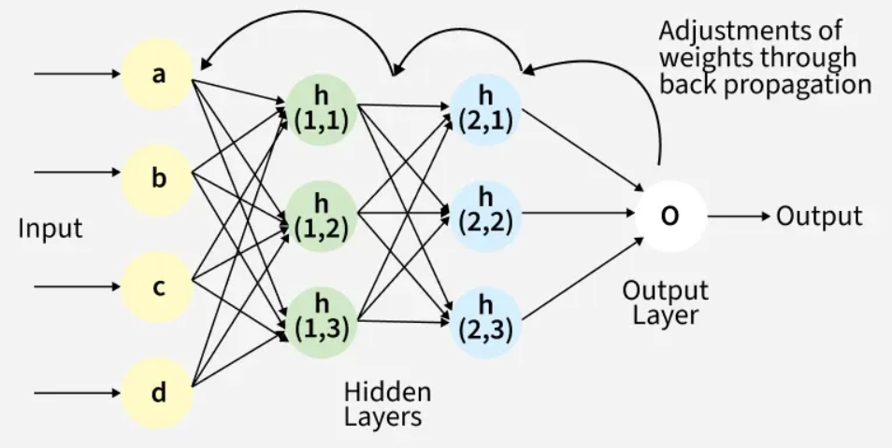
Back propagation

Slide 6
Back propagation
Back Propagation plays a critical role in how neural networks improve over time. Here's why:
Efficient Weight Update: It computes the gradient of the loss function with respect to each weight using the chain rule making it possible to update weights efficiently.
Scalability: The Back Propagation algorithm scales well to networks with multiple layers and complex architectures making deep learning feasible.
Automated Learning: With Back Propagation the learning process becomes automated and the model can adjust itself to optimize its performance.

Slide 7
Working of Back Propagation Algorithm
The Back Propagation algorithm involves two main steps: the Forward Pass and the Backward Pass.
1. Forward Pass Work
In forward pass the input data is fed into the input layer.
These inputs combined with their respective weights are passed to hidden layers.
For example in a network with two hidden layers (h1 and h2) the output from h1 serves as the input to h2.
Before applying an activation function, a bias is added to the weighted inputs.
Each hidden layer computes the weighted sum (`a`) of the inputs then applies an activation function like ReLU (Rectified Linear Unit) to obtain the output (`o`).
The output is passed to the next layer where an activation function such as softmax converts the weighted outputs into probabilities for classification.

Slide 8
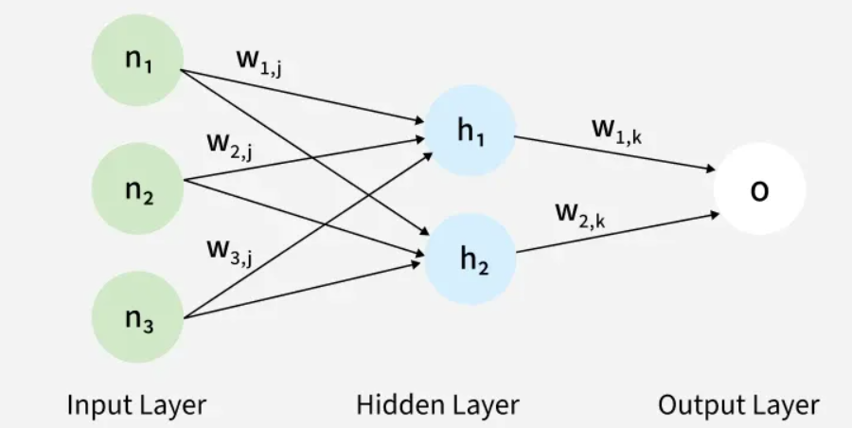
Working of Back Propagation Algorithm

Slide 9
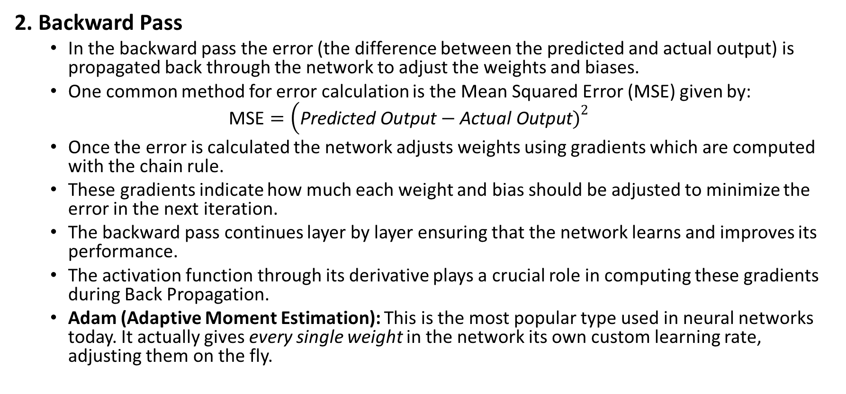
Working of Back Propagation Algorithm
2. Backward Pass
In the backward pass the error (the difference between the predicted and actual output) is propagated back through the network to adjust the weights and biases.
One common method for error calculation is the Mean Squared Error (MSE) given by:
$$\text{MSE}=\left(\text{Predicted} \text{Output}−\text{Actual} \text{Output}{\left.)\right.}^{2}\right.$$
Once the error is calculated the network adjusts weights using gradients which are computed with the chain rule.
These gradients indicate how much each weight and bias should be adjusted to minimize the error in the next iteration.
The backward pass continues layer by layer ensuring that the network learns and improves its performance.
The activation function through its derivative plays a crucial role in computing these gradients during Back Propagation.
Adam (Adaptive Moment Estimation): This is the most popular type used in neural networks today. It actually gives every single weight in the network its own custom learning rate, adjusting them on the fly.

Slide 10
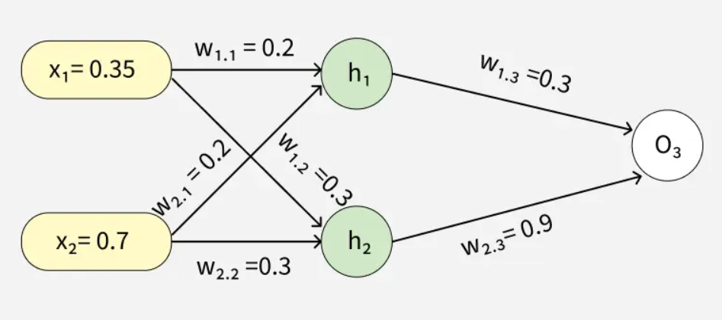
Example of Back Propagation
Assume the neurons use the sigmoid activation function for the forward and backward pass. The target output is 0.5 and the learning rate is 1.

Slide 11


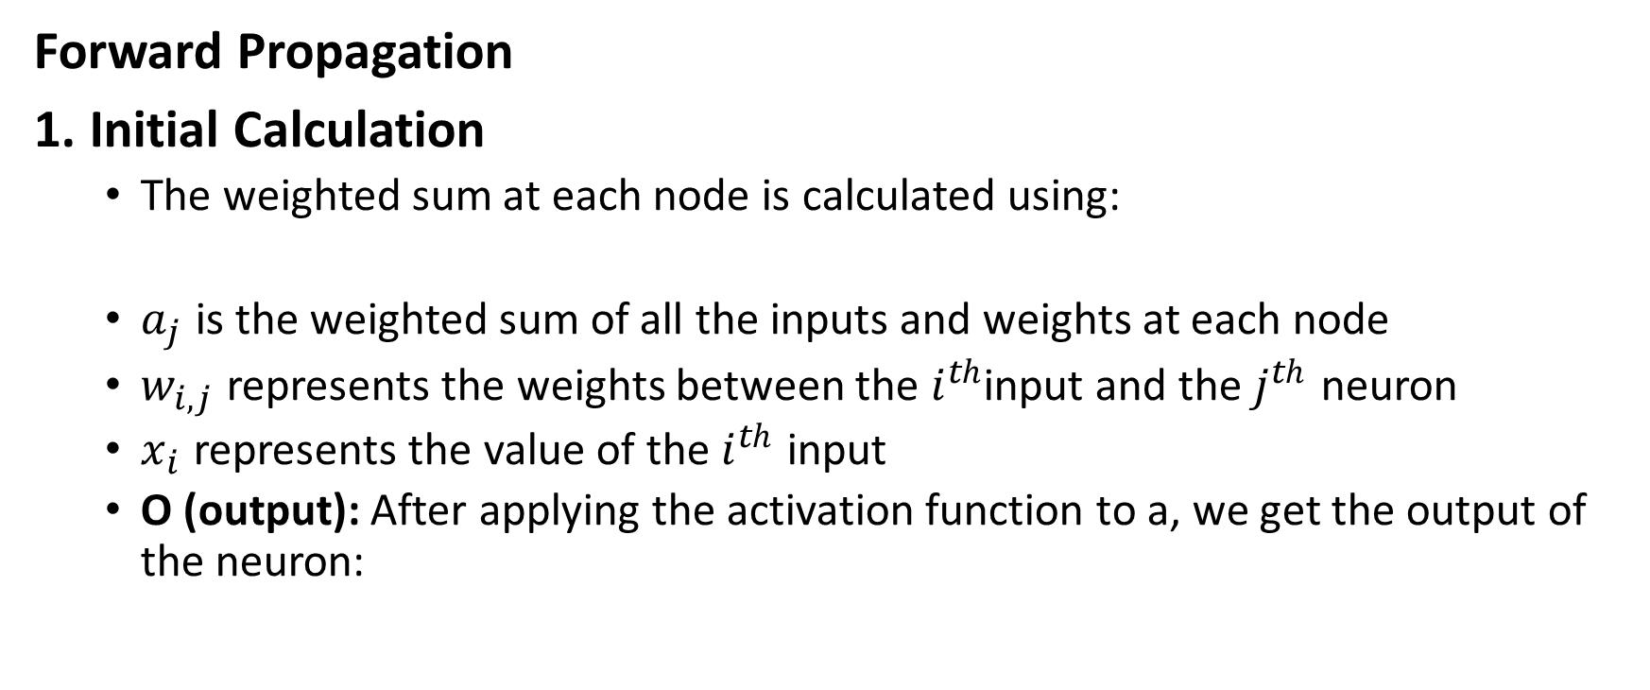
Example of Back Propagation
Forward Propagation
1. Initial Calculation
The weighted sum at each node is calculated using:
$a_{j}$ is the weighted sum of all the inputs and weights at each node
$w_{i,j}$ represents the weights between the $i^{th}$input and the $j^{th}$ neuron
$x_{i}$ represents the value of the $i^{th}$ input
O (output): After applying the activation function to a, we get the output of the neuron:

Slide 12

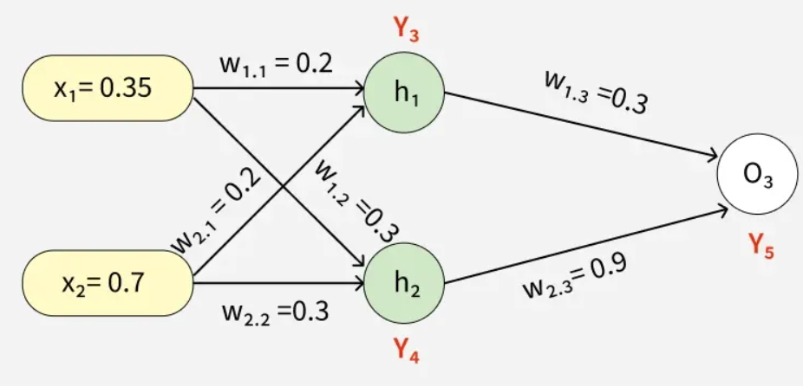
Example of Back Propagation
2. Sigmoid Function
The sigmoid function returns a value between 0 and 1, introducing non-linearity into the model.

Slide 13
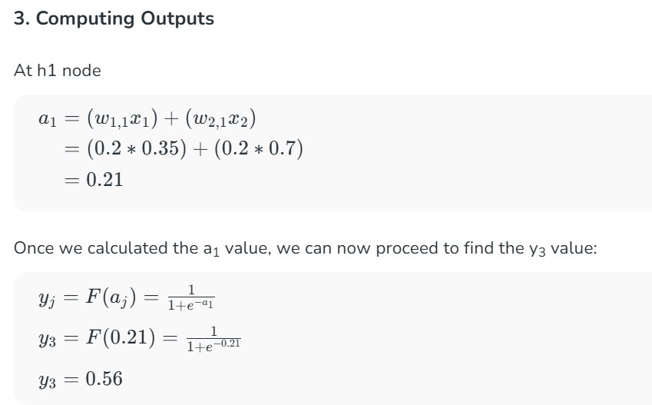
Example of Back Propagation

Slide 14
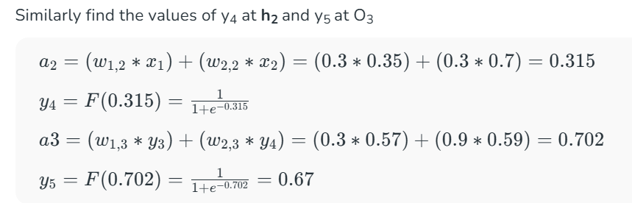
Example of Back Propagation
= 0.59

Slide 15
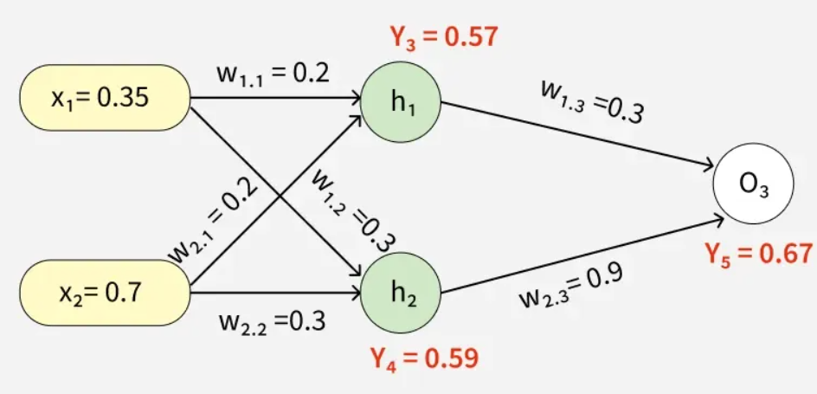
Example of Back Propagation

Slide 16
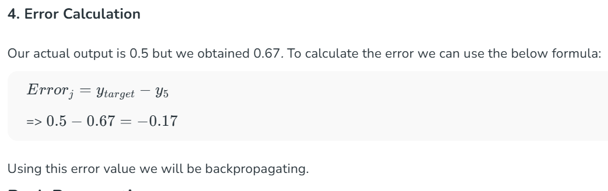
Example of Back Propagation

Slide 17
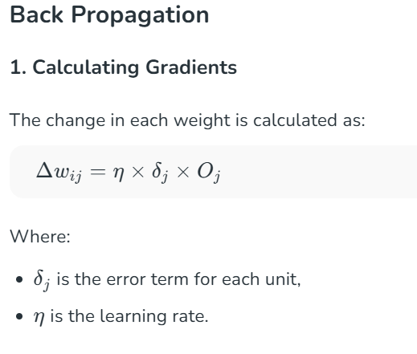
Example of Back Propagation
Oj is the predicted value for each unit

Slide 18
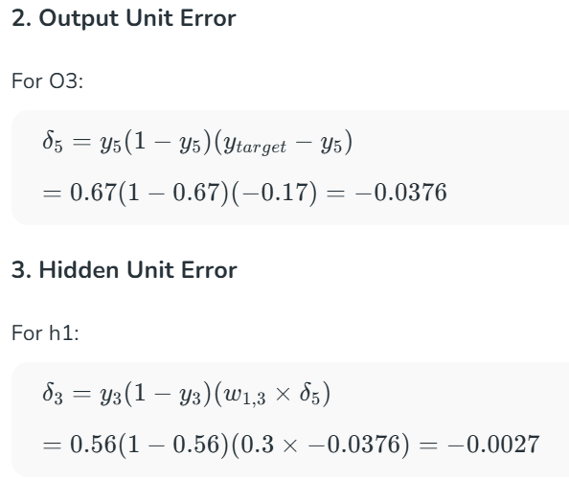
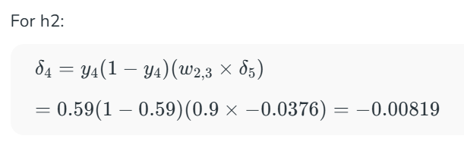
Example of Back Propagation
For output unit
δi = yi(1-yi)(ytarget – yi)
For hidden unit
δi = yi(1-yi)(wij x δj)

Slide 19
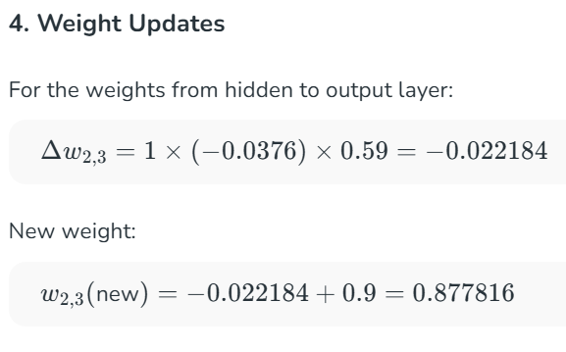

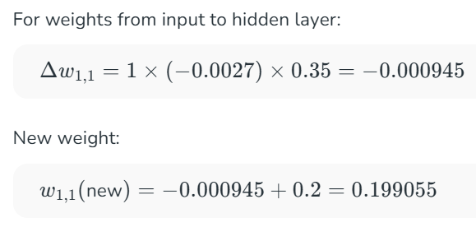
Example of Back Propagation

Slide 20
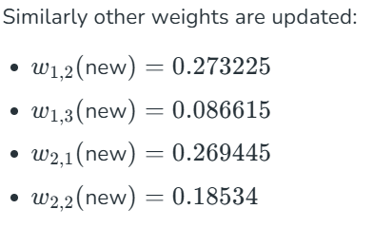
Example of Back Propagation

Slide 21
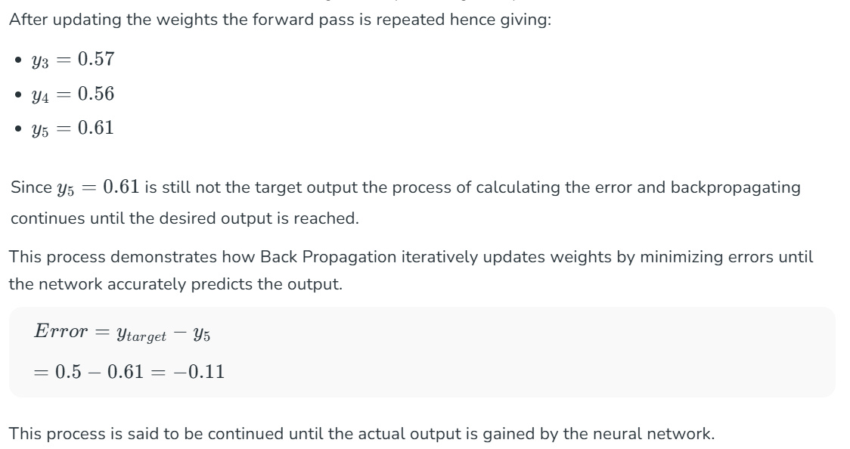
Example of Back Propagation

Slide 22
Advantages of Back Propagation
Ease of Implementation: Back Propagation is beginner-friendly requiring no prior neural network knowledge and simplifies programming by adjusting weights with error derivatives.
Simplicity and Flexibility: Its straightforward design suits a range of tasks from basic feedforward to complex convolutional or recurrent networks.
Efficiency: Back Propagation accelerates learning by directly updating weights based on error especially in deep networks.
Generalization: It helps models generalize well to new data improving prediction accuracy on unseen examples.
Scalability: The algorithm scales efficiently with larger datasets and more complex networks making it ideal for large-scale tasks.

Slide 23
Challenges of Back Propagation
While Back Propagation is useful it does face some challenges:
Vanishing Gradient Problem: In deep networks the gradients can become very small during Back Propagation making it difficult for the network to learn. This is common when using activation functions like sigmoid or tanh.
Exploding Gradients: The gradients can also become excessively large causing the network to diverge during training.
Overfitting: If the network is too complex it might memorize the training data instead of learning general patterns.

